Slide 1
Now I am going to show you
A Project on Hotel Booking management System
In this project I have tried to focus only on Spring
Mechanism. Here you will be able to find how to transfer
Data to another pages. To make this project I have used IntelliJ JetBrain IDEA.

Slide 2
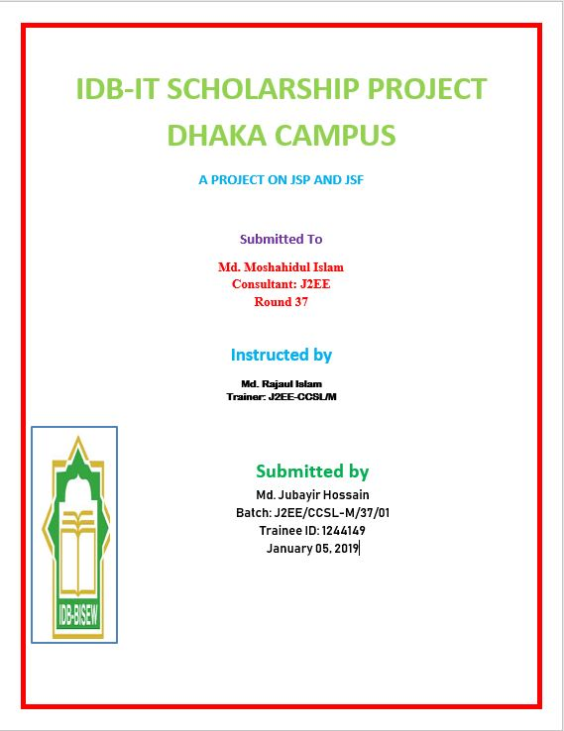

Slide 3
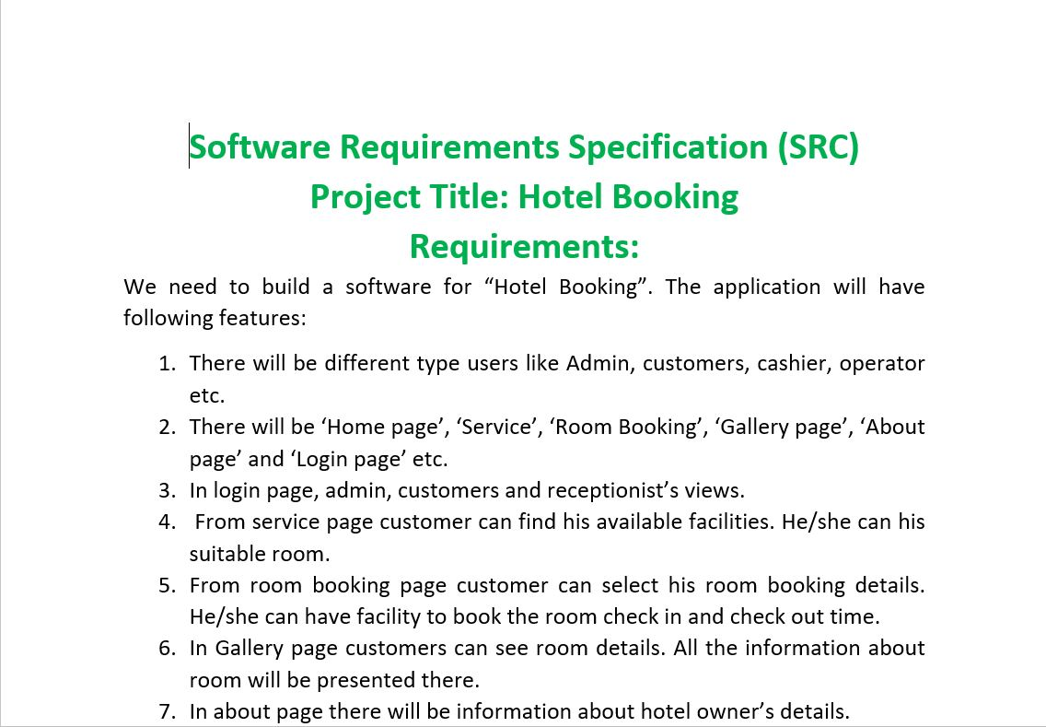
SRC INFORMATION

Slide 4
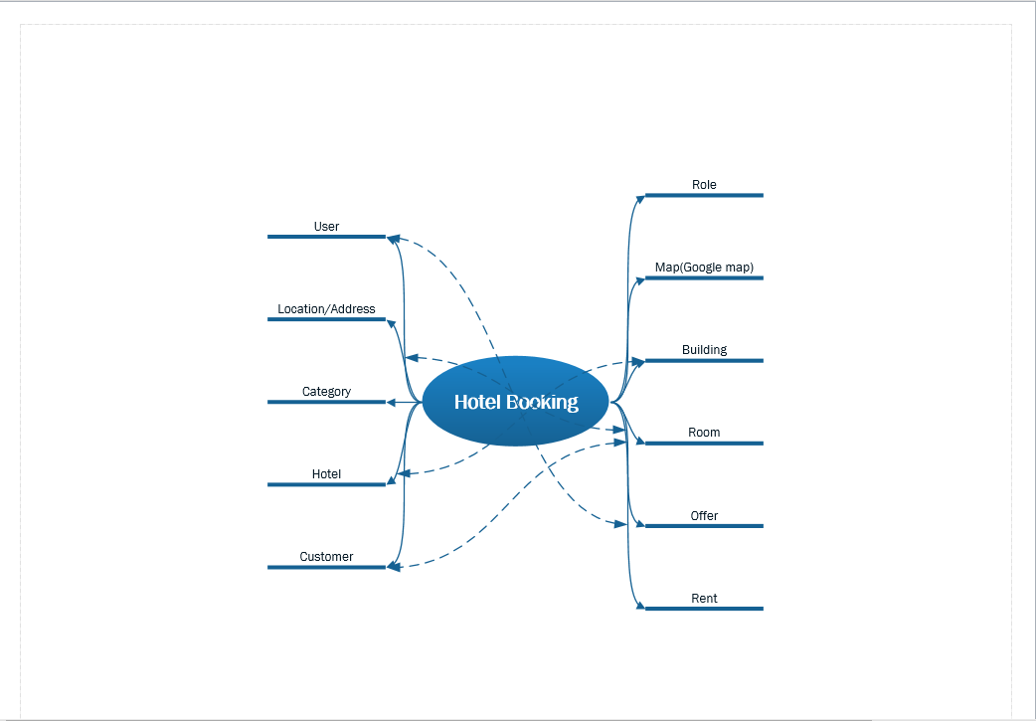
UML BRAINSTORM SHAPE

Slide 5
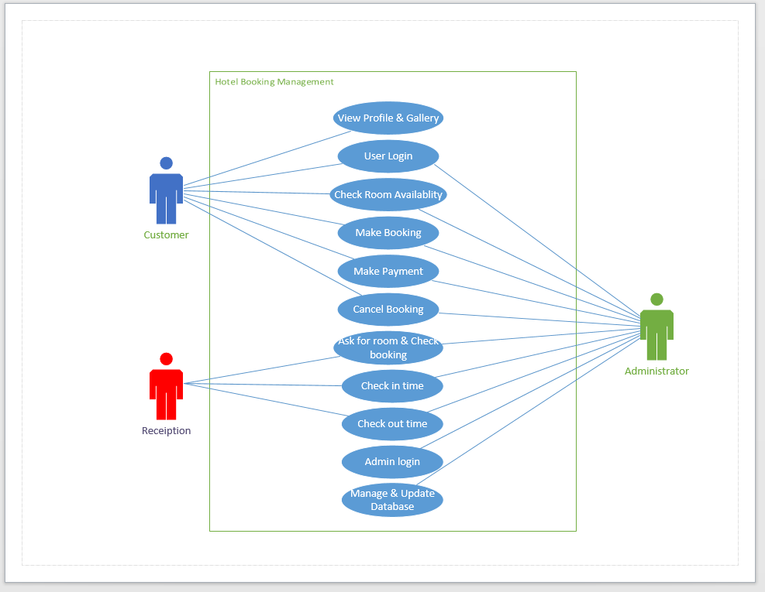
UML USE CASE DIAGRAM

Slide 6
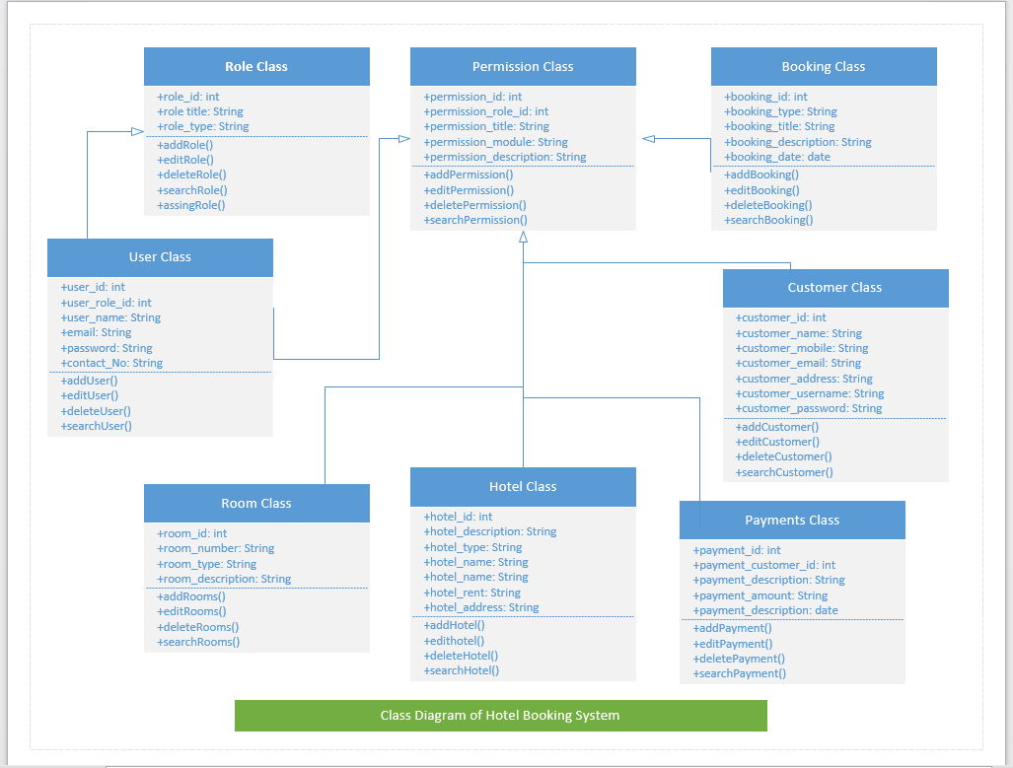
UML CLASS DIAGRAM

Slide 7
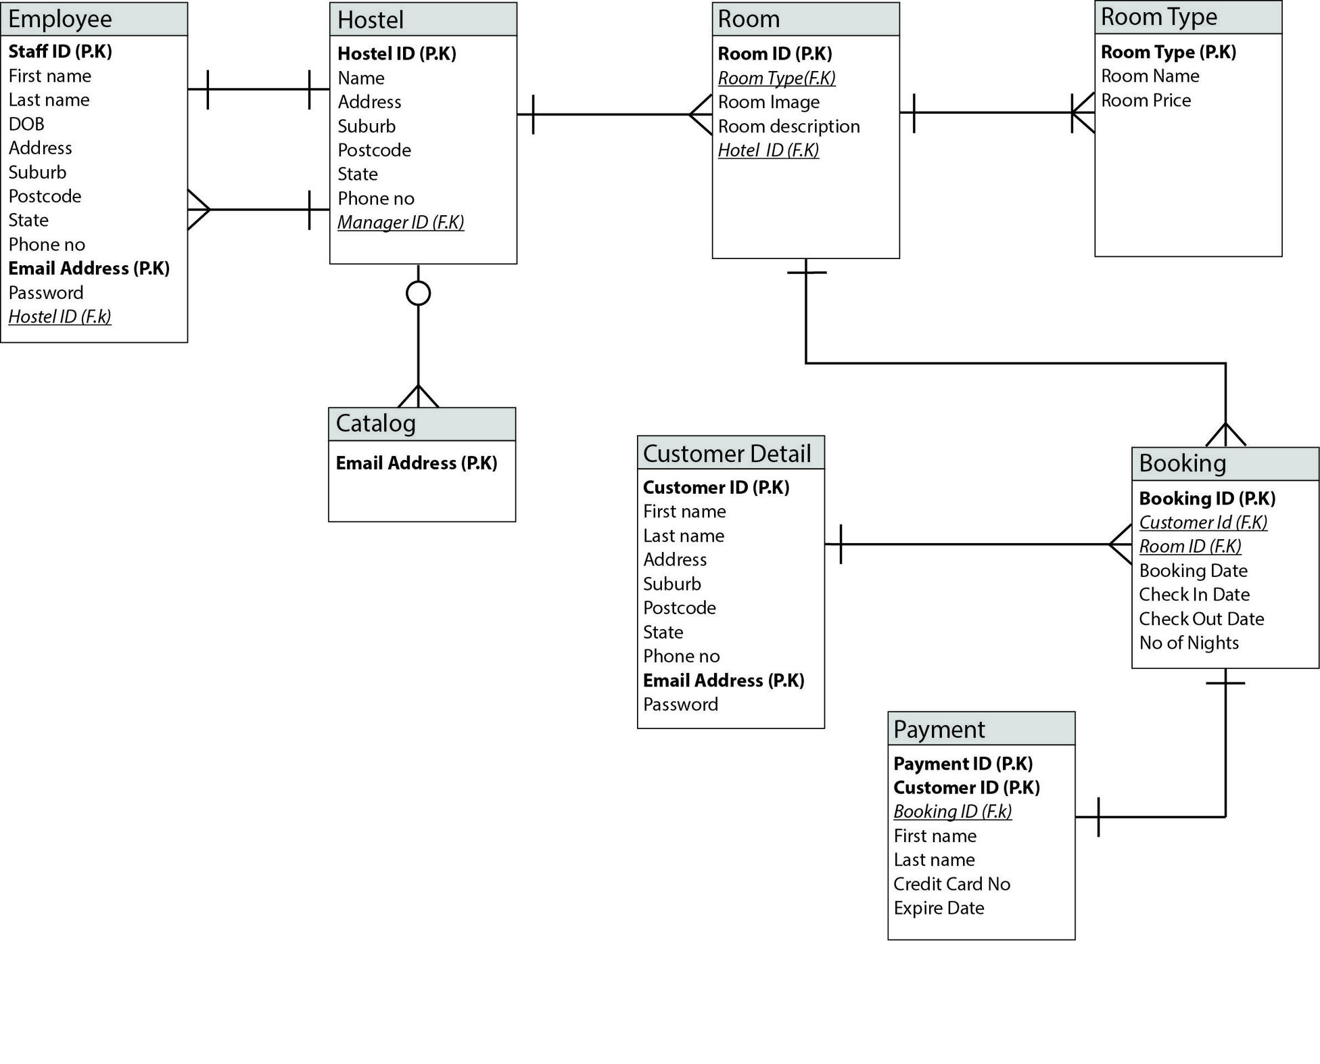
ENTITY RELATIONSHIP

Slide 8
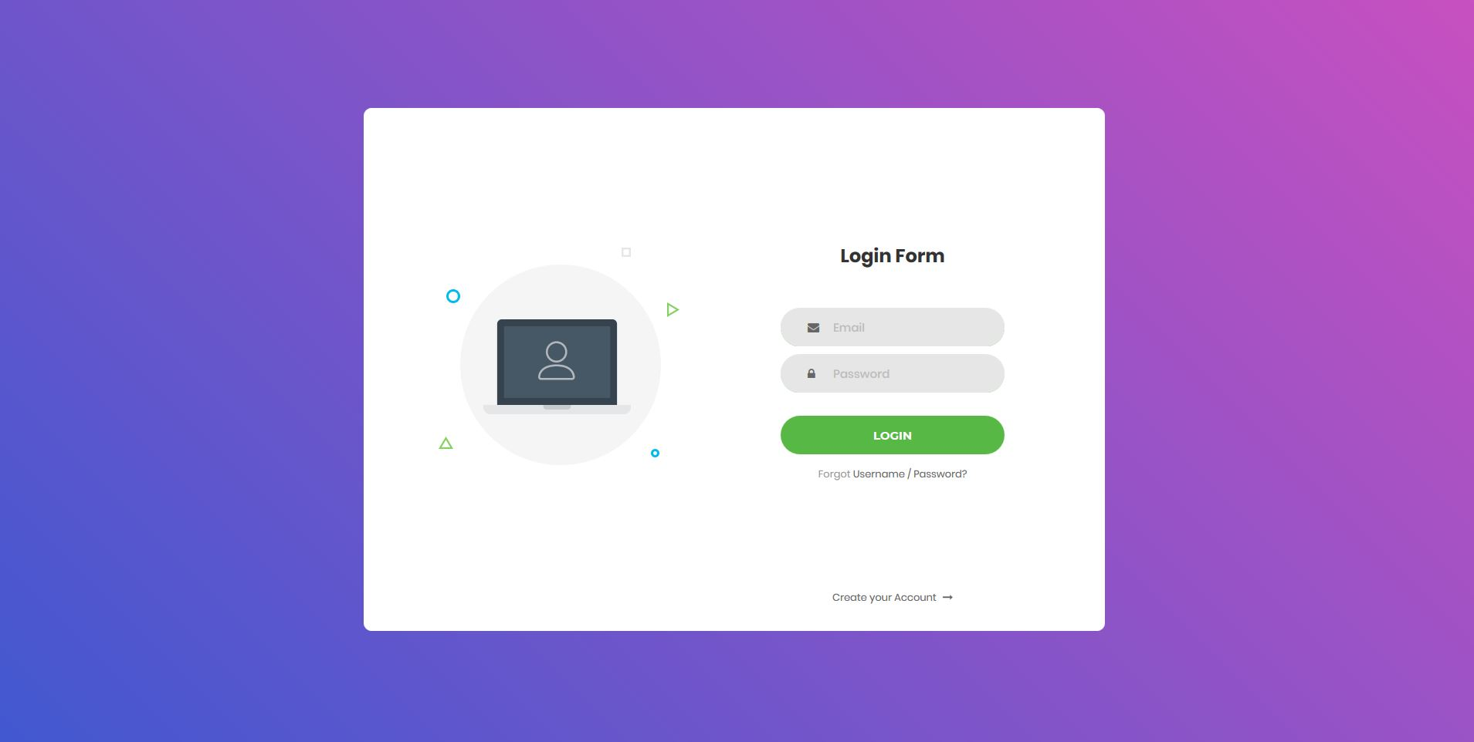
Login View

Slide 9
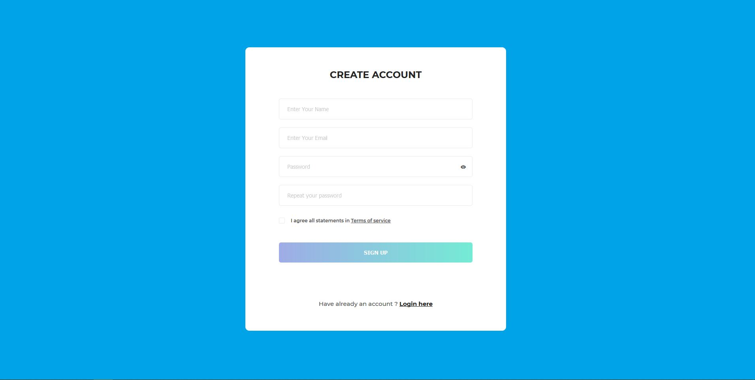
Sign Up View

Slide 10
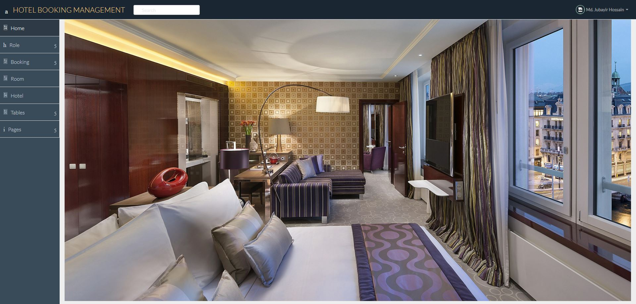
Home Page

Slide 11
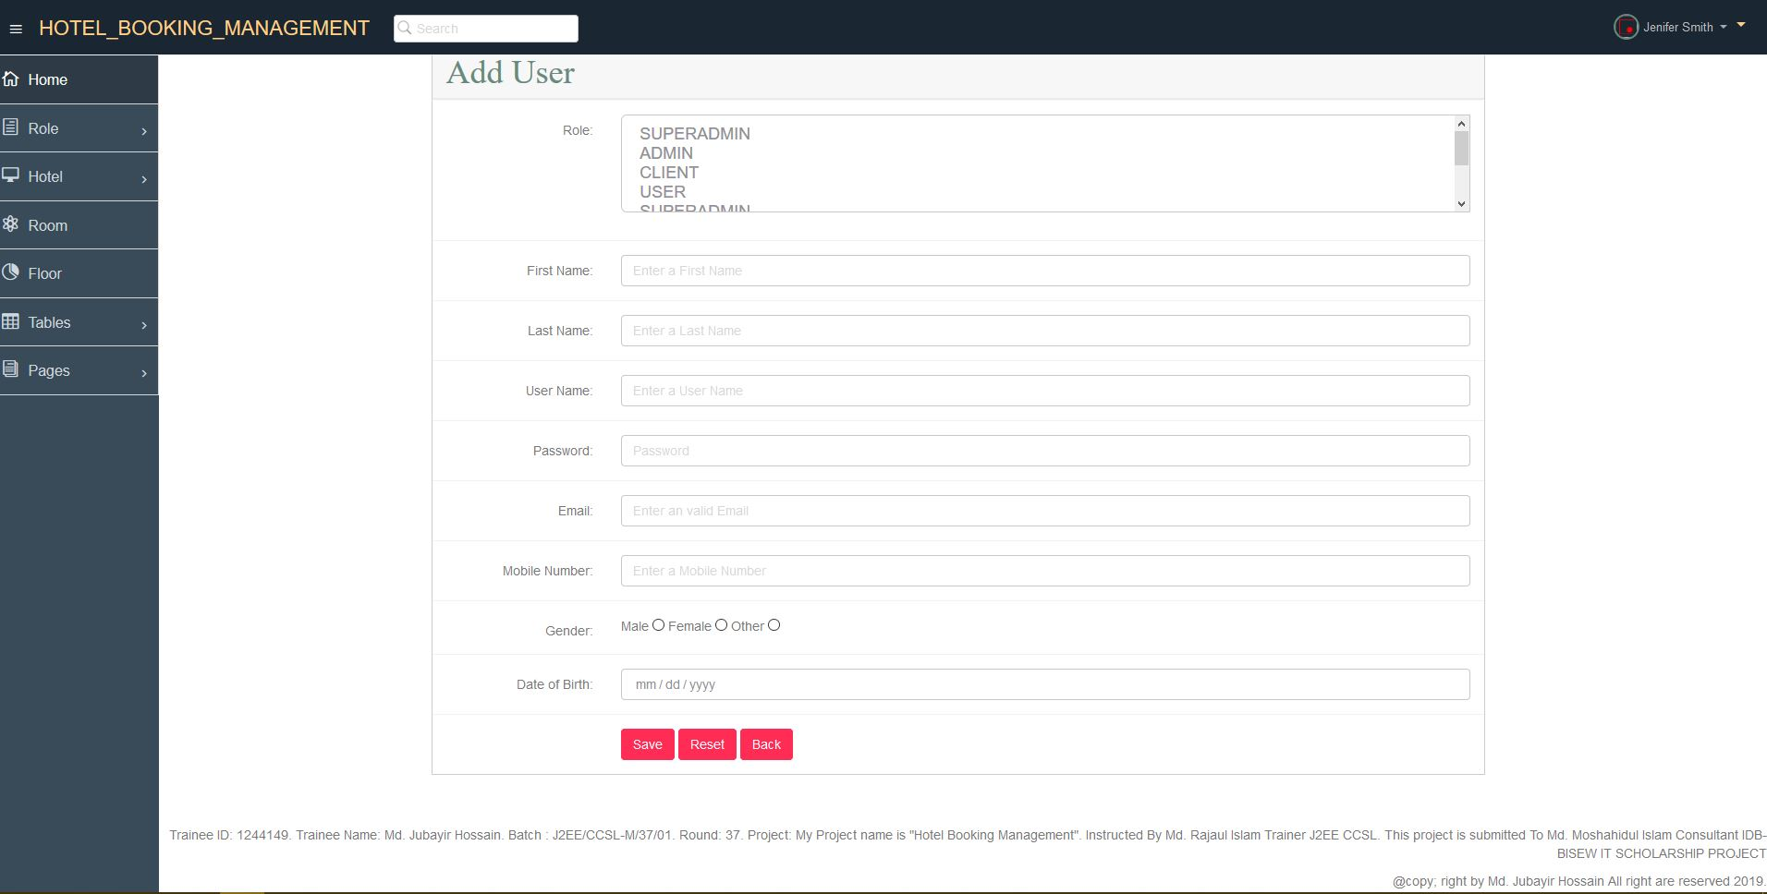
USER INPUT VIEW

Slide 12
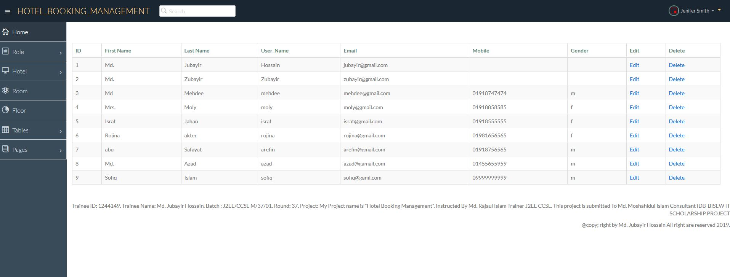
USER LIST

Slide 13
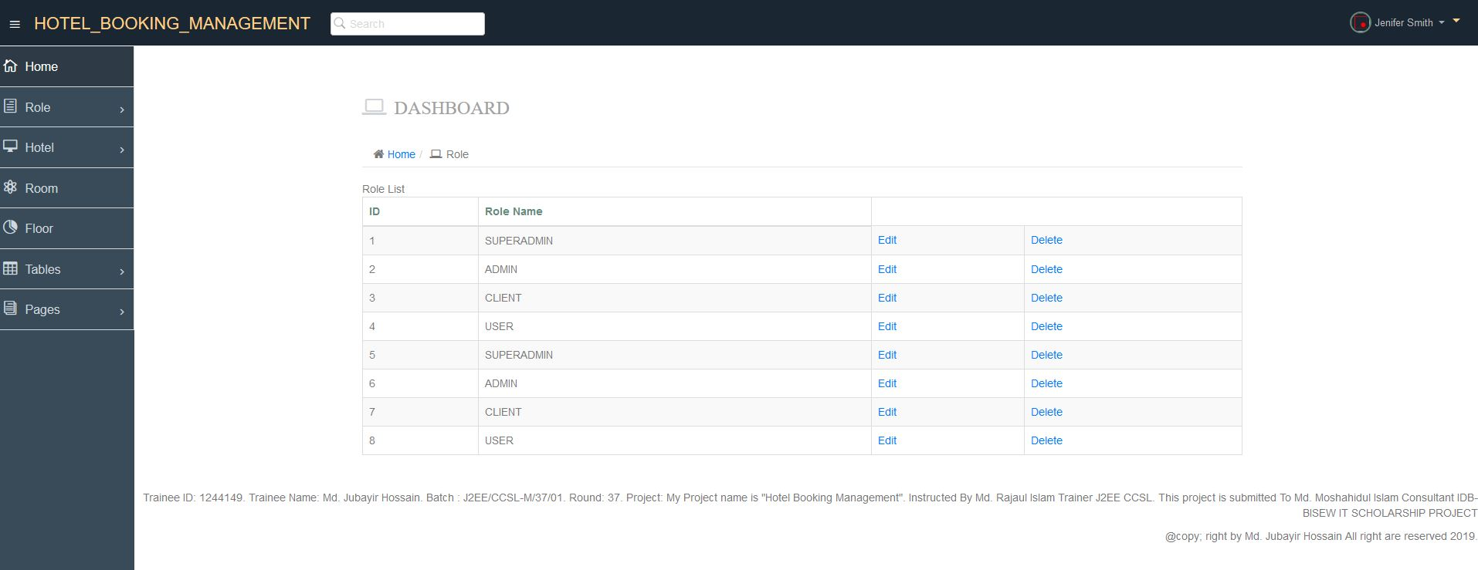
ROLE LSIT

Slide 14
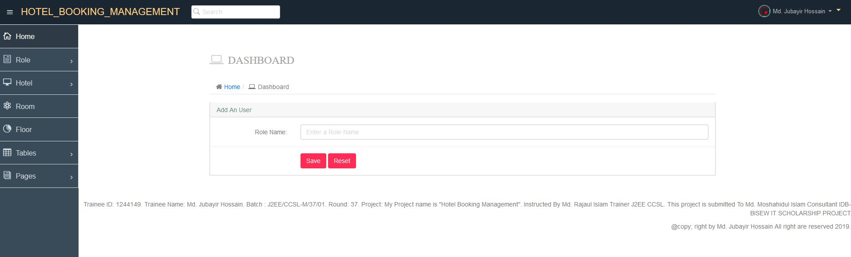
ADD ROLE

Slide 15
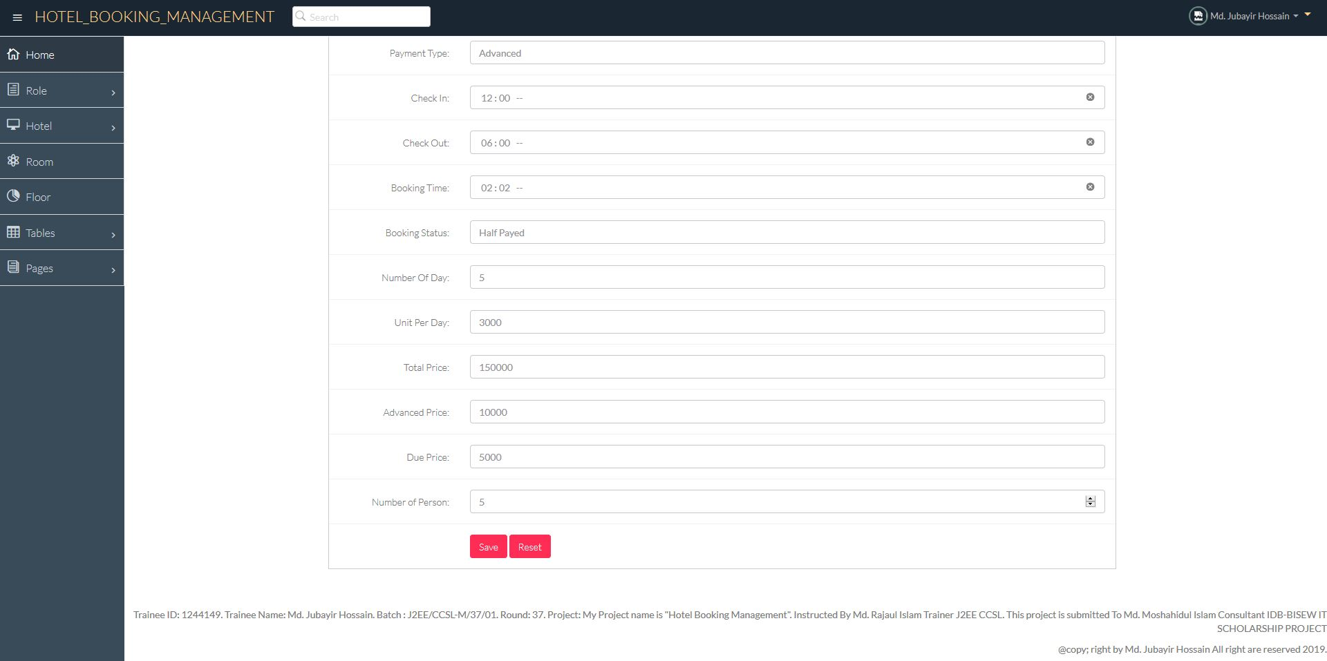
BOOKING FORM

Slide 16
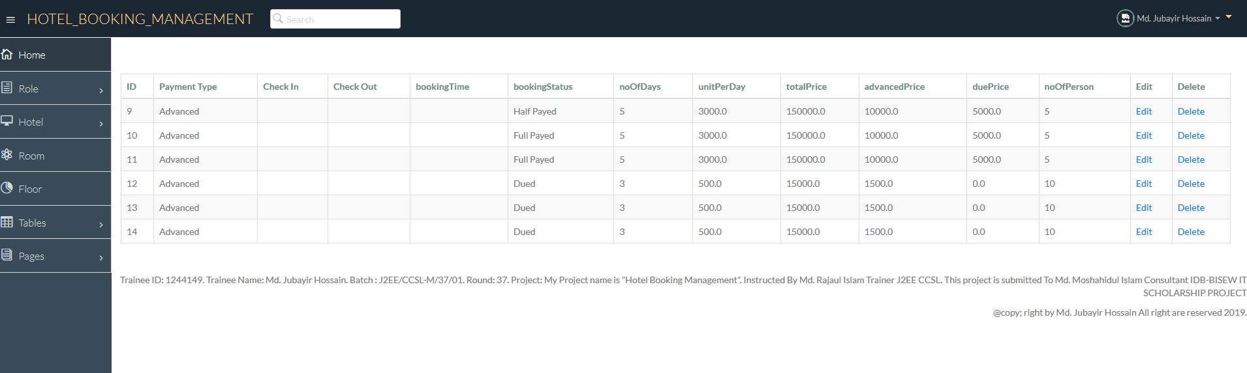
BOOKING LIST

Slide 17
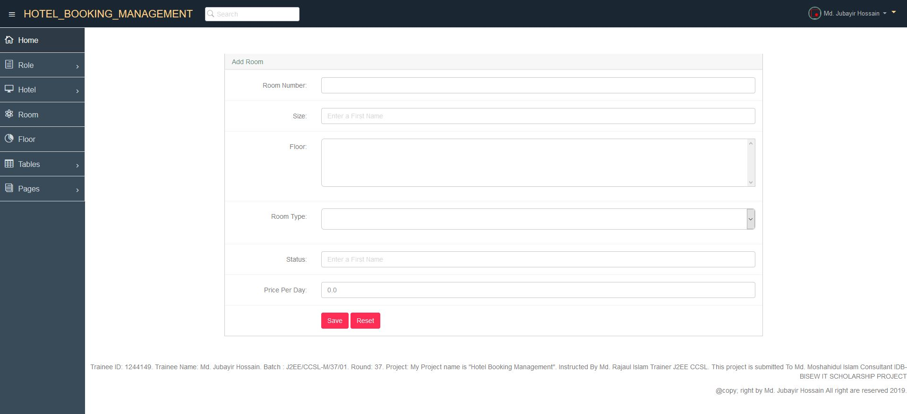
ROOM ADDING

Slide 18
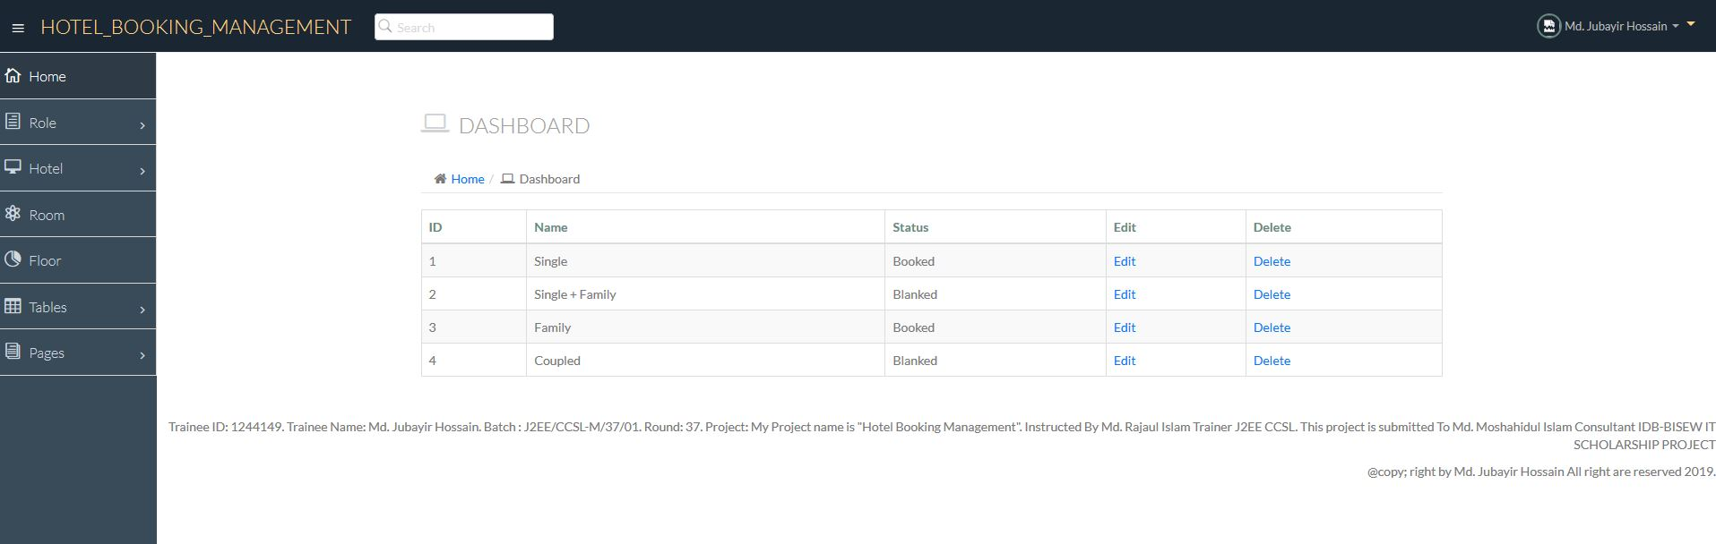
ROOM LIST

Slide 19
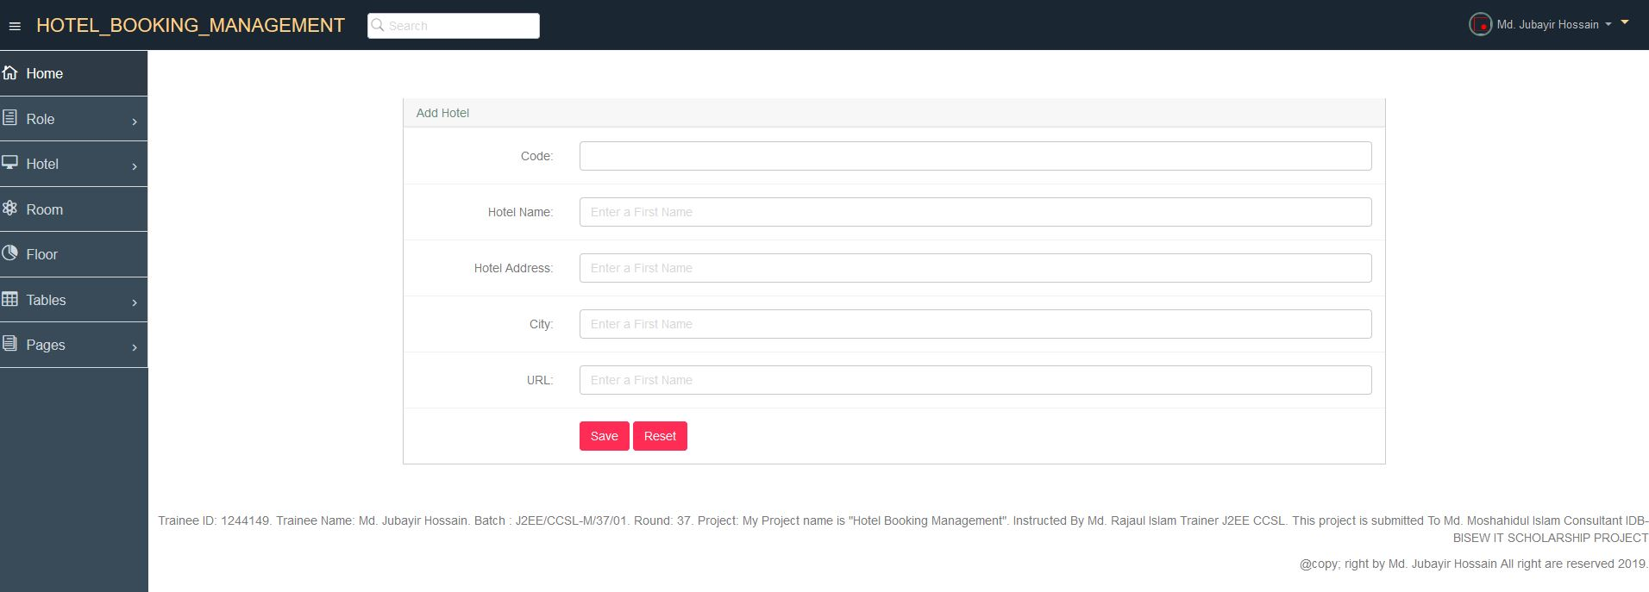
HOTEL ADDING

Slide 20
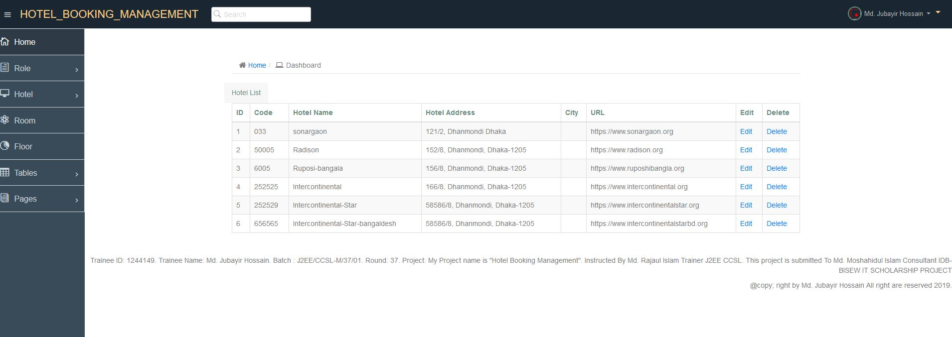
HOTEL LIST

Slide 21
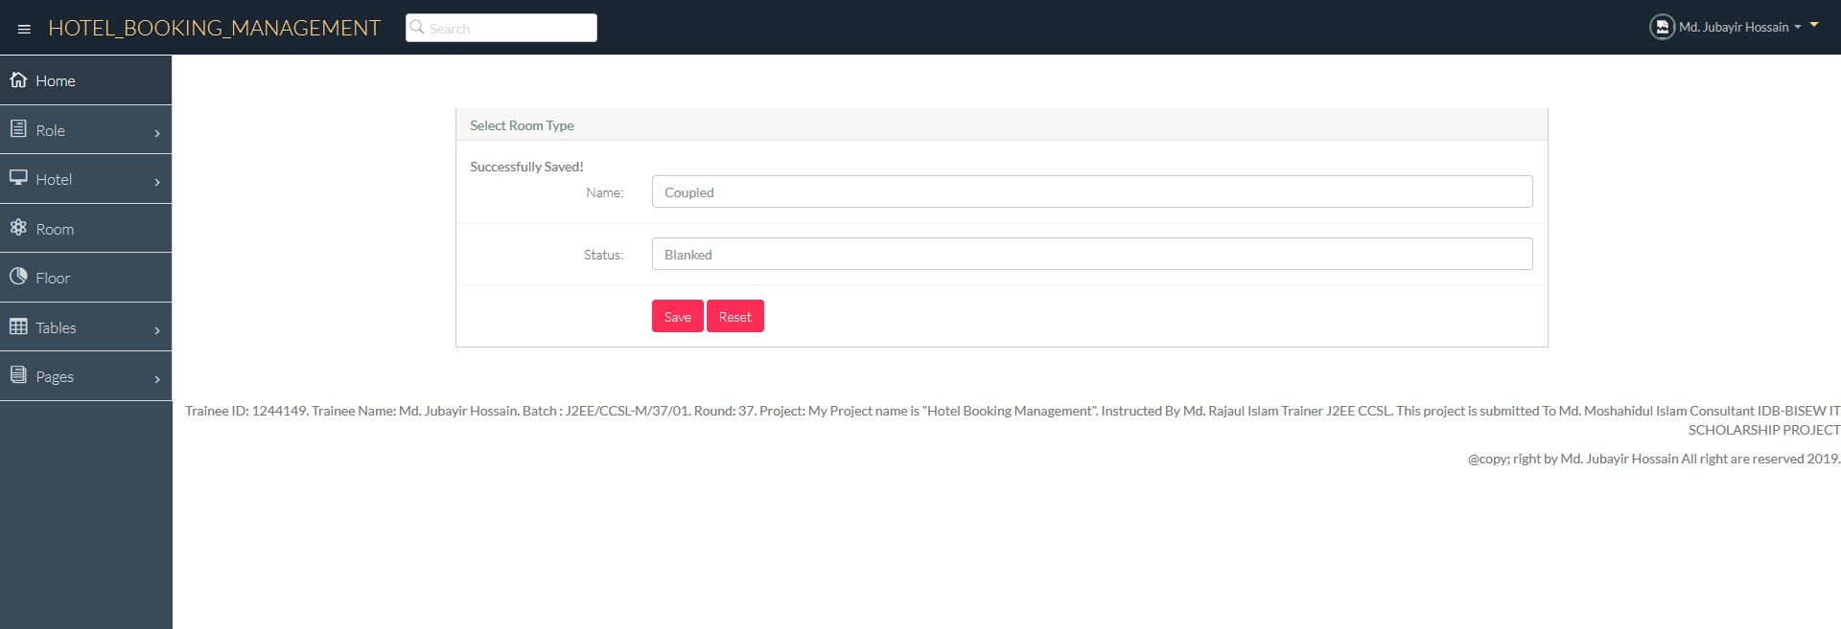
ROOM TYPE

Slide 22
ROOM TYPE LIST

Slide 23
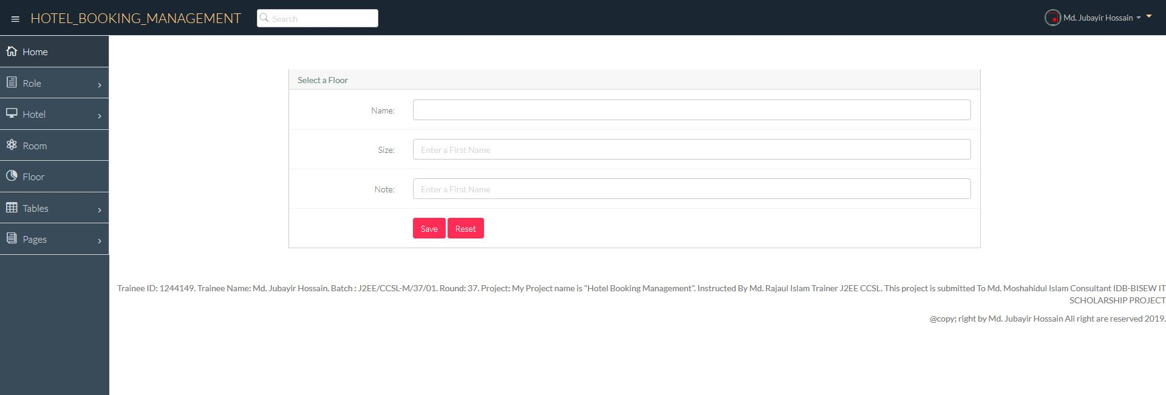
ADD FLOOR

Slide 24
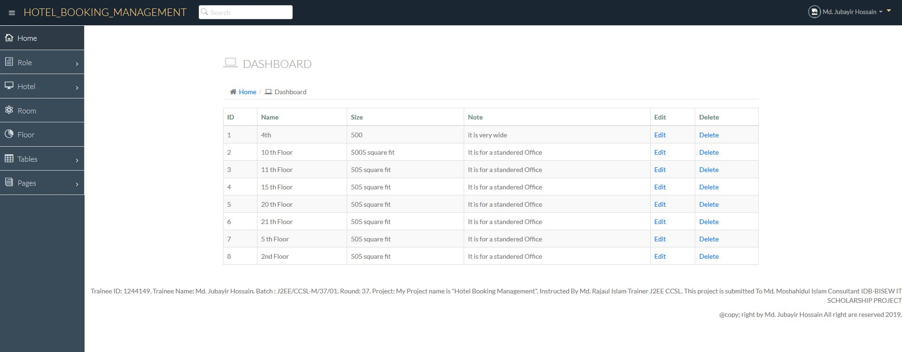
FLOOR LIST

Slide 25
Thank You Sir

